Slide 1
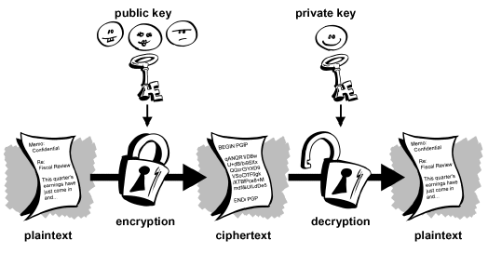
MicroBlaze-Based Processor on FPGA for Elliptic Curve Cryptography Implementation
Grant Genie, Daisy Guzman, Newton Le, Laurice Sattouf, Andro Younan, Mohamed El- Hadedy
gtgenie@cpp.edu, dguzman@cpp.edu, newtonle@cpp.edu, lsattouf@cpp.edu, ayounan@cpp.edu, mealy@cpp.edu Department of Electrical and Computer Engineering
College of Engineering,
California Polytechnic State University Pomona, California

Slide 2

Introduction
With the importance of cryptography and its techniques for ensuring a secure communication, more efficient and powerful algorithms are needed to keep the performance at its best with less power and resources.
The Elliptic Curve Cryptography (ECC) is a fast and more secure method of encryption, compared to the Public-Key Cryptographic algorithms of RSA.
ECC provides high security with much shorter algorithms.
The performance of the ECC protocol greatly depends on the efficient implementation of the scalar multiplication operation. However, different techniques for optimizing scalar multiplication operation and optimization can be achieved at a different level of computation.

Slide 3
Target Hardware
The goal of this study is to utilize the Xilinx MicroBlaze processor in various hardware configuration to analyze performance and source tradeoff while running the ECC cryptography algorithm.
Discuss the multiplication algorithms and implementations to use this network security in a MicroBlaze processor using a Field - programmable gate arrays (FPGA -Xilinx Nexys7) based system implementation.
Obtain the performance metrics and analyze the results to evaluate the Multiplication Algorithms.
Notes:
ECC cryptography

Slide 4
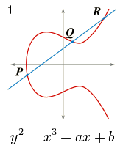
Discrete logarithmic problem for elliptic curves
Given the starting and ending points as public key, it’s extremely difficult to figure out how many steps it takes to move from one point to another on that curve(the private key), which makes the Elliptic curve one the most efficient way in cryptography.
Notes:
Public and private keys

Slide 5
Field of operation
The elliptic curve functions over two finite fields:
- the prime field.
- binary field.
Binary curves are smaller and faster in hardware than the prime field:
This is because they have shorter formulas, binary squaring is linear, and the binary field does not contain the carry function.
Binary Field Order 4 - Elements are the 2^4 binary polynomials of at most degree 3
Notes:
Prime vs binary

Slide 6
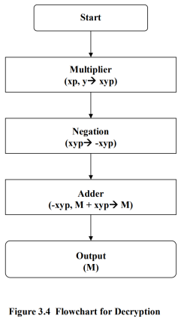
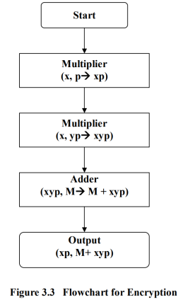
Implementation flow charts
Notes:
Flow chart!

Slide 7
Design Architecture
Polynomial Equation
Binary Field Arithmetic
Modules Implemented

Slide 8
A- Polynomial Equation y^2 + xy = x^3 + ax^2 + b
Reduction Polynomial: When we multiply two polynomials, we will gather results with a degree larger than the original value. In our case, this will be larger than order of four, in our modules we reduce the results from the multiplication and reduce it to fit onto our desired registers
we choose between three irreducible functions which remains constant throughout our project:
f₁(z) = z⁴ + z + 1 (used throughout our project)
f₁(z) = z⁴ + z³ + 1
f₁(z) = z⁴ + z³ + z² + x + 1
Notes:
z⁴ + z + 1, irreducible polynomial function

Slide 9
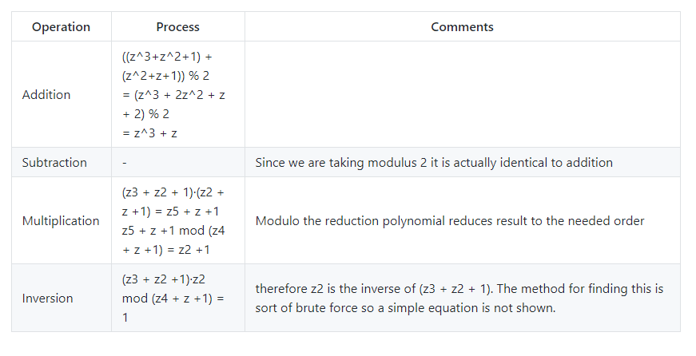
B- Binary Arithmetic operations:
Notes:
comments

Slide 10
C- Modules Implemented:
Point addition (and point negation):
INPUT: P = (X₁ : Y₁ : Z₁) in LD coordinates,
Q = (x₂, y₂) in affine coordinates on
E/K: y² + xy = x³ + ax² + b.
OUTPUT: P + Q = (X₃ : Y₃ : Z₃) in LD coordinates.
Point doubling
INPUT: P = (X₁ : Y₁ : Z₁) in LD coordinates on
E/K : y² + xy = x³ + ax² + b.
OUTPUT: 2P = (X₃ : Y₃ : Z₃) in LD coordinates.
Point scaler Multiplication -Add Shift Method :
INPUT: k = (k_{t – 1}, …, k₁, k₀)₂, P ∈ E(F_{q}).
OUTPUT: kP
Point Scalar Multiplication Windowed
INPUT: Binary polynomials a(z) and b(z) of
degree at most m - 1.
OUTPUT: c(z) = a(z) * b(z).
Notes:
Quick explanation of each?

Slide 11
C- Modules Implemented:(cont..)
Polynomial addition
Polynomial inverse
Polynomial multiplication
Encryption
Decryption

Slide 12
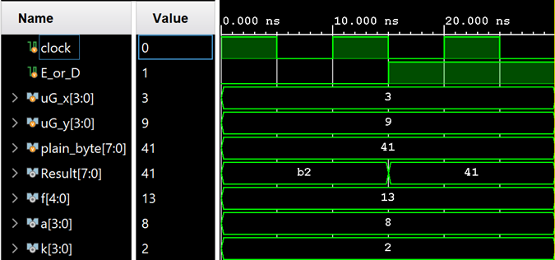
Results
E_or_D – value of 0/1 = encrypt/decrypt
plain_byte – message to be encrypted
k – randomly generated number for scalar multiplication
uG_x and uG_y – keys that we need to start the encryption process
Notes:
Explain inputs and outputs – plain_byte and the decrypted result!

Slide 13
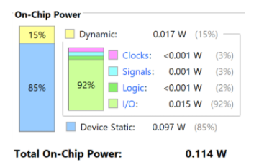
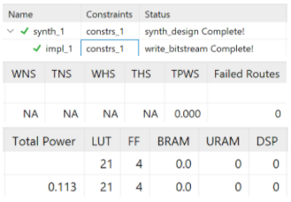
Comparison and Evaluation
Same power utilization
Pulse width slack for both algorithms was 4.5 ns
No major differences between the two algorithms

Slide 14

Future Work
Future work concerns deeper analysis of software based elliptic curve cryptography and the benefits of using the hardware-based path
Notes:
Comparison software vs hardware

Slide 15
References
Hankerson, D., Menezes, A. and Vanstone, S., n.d. Guide To Elliptic Curve Cryptography. [Online] Citeseerx.ist.psu.edu. Available at: <https://citeseerx.ist.psu.edu/viewdoc/download?doi=10.1.1.394.3037&rep=rep1&type=pdf> [Accessed 18 November 2020]
A. MS, "Elliptic Curve Cryptography - An Implementation Tutorial - dkrypt.com", Sites.google.com. [Online]. Available: https://sites.google.com/site/csnewandold/home/ecc#TOC-Conclusion. [Accessed: 18- Nov- 2020]
D. Susantio and I. Muchtadi-Alamsyah, "Implementation of Elliptic Curve Cryptography in Binary Field", Iopscience.iop.org, 2016. [Online]. Available: https://iopscience.iop.org/article/10.1088/1742-6596/710/1/012022/pdf. [Accessed: 19- Nov- 2020]
"THE PROPOSED SYSTEM OF IMPLEMENTING ELLIPTIC CURVE CRYPTOGRAPHY USING VERILOG HDL", Shodhganga.inflibnet.ac.in, 2020. [Online]. Available: https://shodhganga.inflibnet.ac.in/bitstream/10603/27232/8/08_chapter3.pdf. [Accessed: 25- Nov- 2020]

Slide 16


